Slide 1
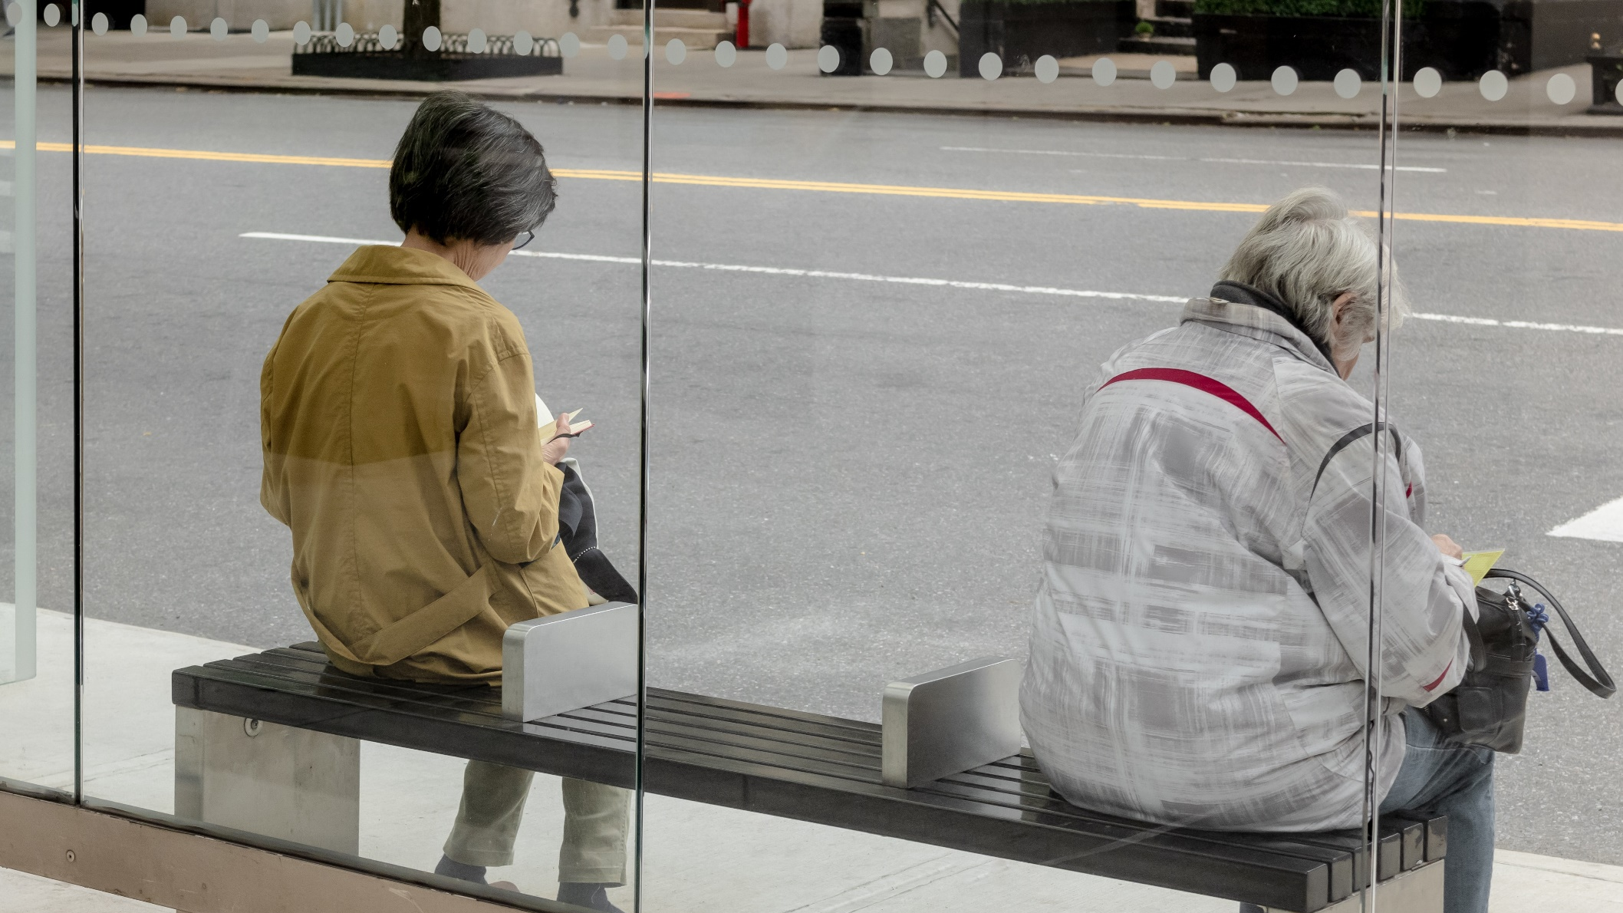
Did stringency measures influence happiness across the world over the course of the pandemic? Benjamin Strusch, Nils Müller, Svea Graupner

Slide 2
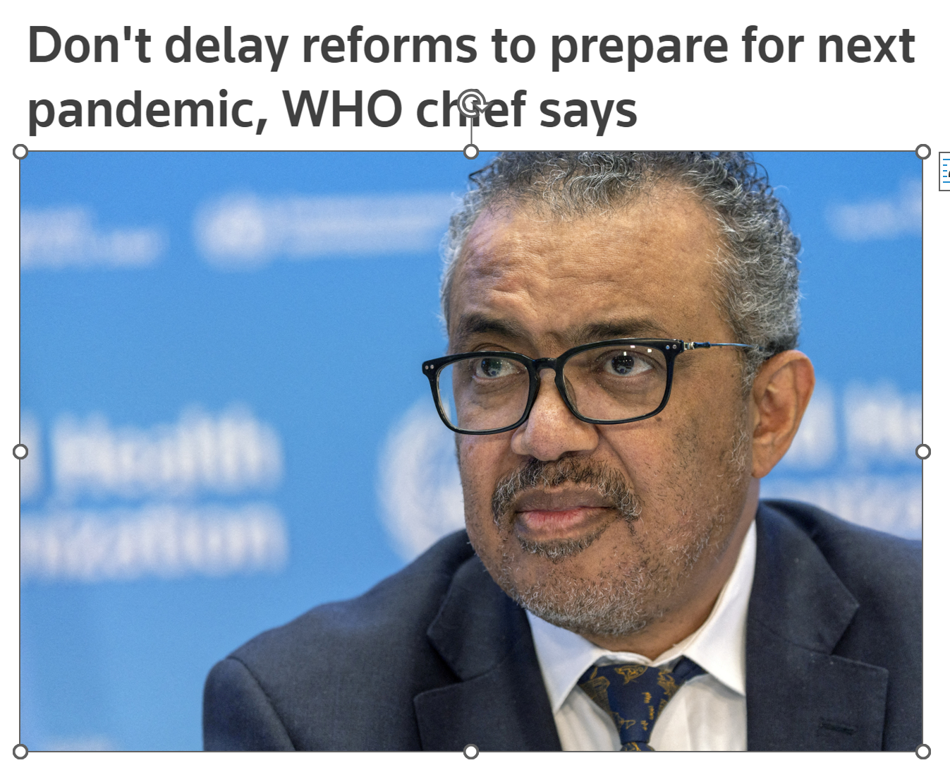

Did stringency influence happiness across the world over the course of the pandemic?

Slide 3
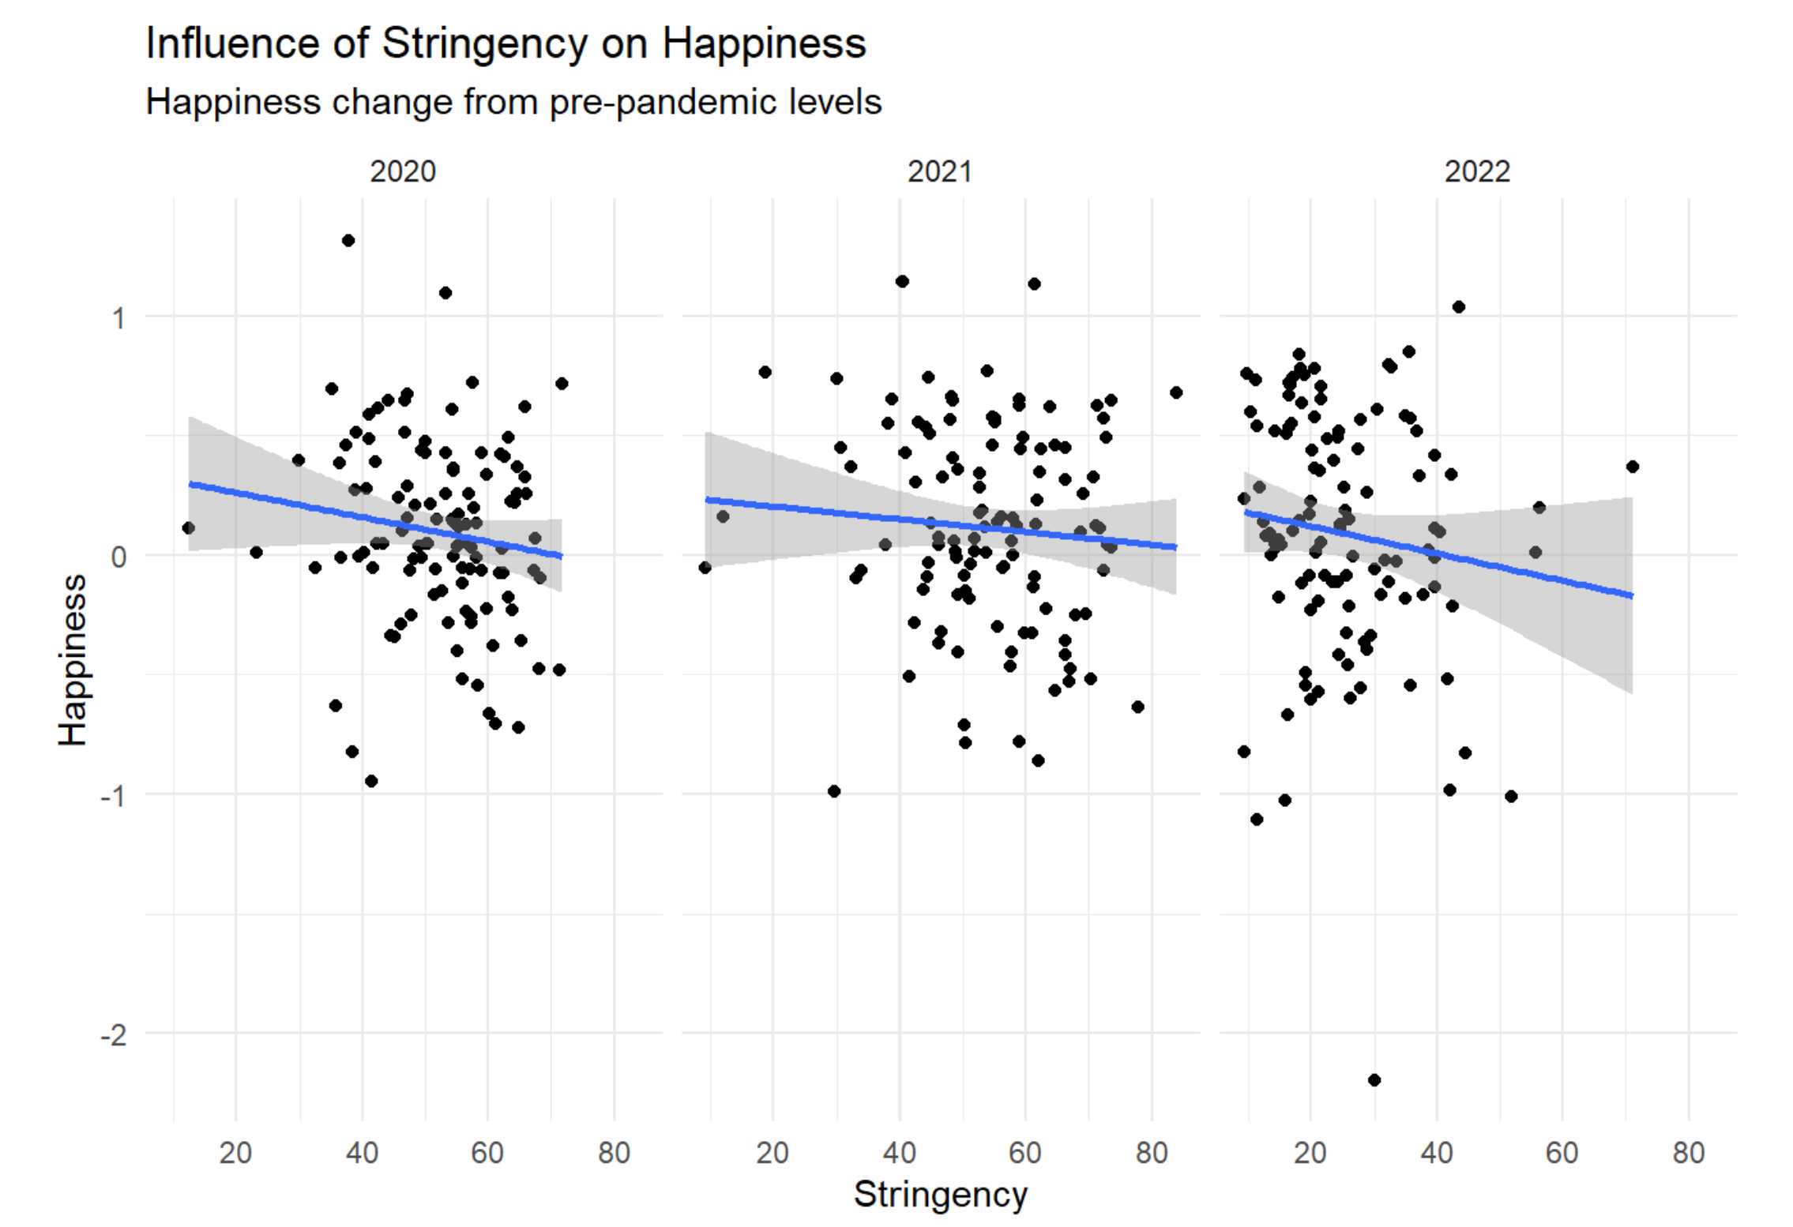

Slide 4





